Slide 1

Provost's Council - October 26, 2021
Budget Presentation SUNY Old Westbury
Report for the
FY 2021-2022
Prepared by
Business & Finance

Slide 2

Matters on the Docket
A brief look at what we will discuss on this presentation
01
Revenue Sources
02
Budget Terms
03
Annual Budget Cycle
04
FY 2021-2022 Budgets and Allocations
05
Budgets FYs 20-21 vs. 21-22
Continued…

Slide 3
Matters on the Docket
A brief look at what we will discuss on this presentation
06
Factors Affecting Financial Situation
07
Student Enrollment
08
Temporary Spending Constraints
09
ARP - HEERF III

Slide 4






01
Revenue Sources
Reserves, HEERF III 14.1%
STUDENT TUITION
STATE SUPPORT
Fees & Rentals
15.2%
Student Tuition
44.6%
RESIDENCE HALLS
REVENUE
Sources
FEES & RENTALS
Residence Halls
7.6%
RESERVES
State Support
18.5%

Slide 5

02
Personal Services Regular. This category represents all salaried employees of OW.
Budget Terms
PSR
Other Than Personnel Services.
This category includes supplies, utilities, travel, contracts, software, equipment, etc.
OTPS
Temporary Services. This category represents all temporary personnel of OW, including adjuncts, consultants, etc.
TS
This category includes payments to SUNY for SUNY-provided services to OW, such as servers, programming, etc.
Recharges
Dormitory Income Fund Reimbursable. Revenue from the operations of student residence halls.
DIFR
Income Fund Reimbursable. Revenue from student fees (e.g., technology, transportation, health, athletics) and other revenue.
IFR

Slide 6
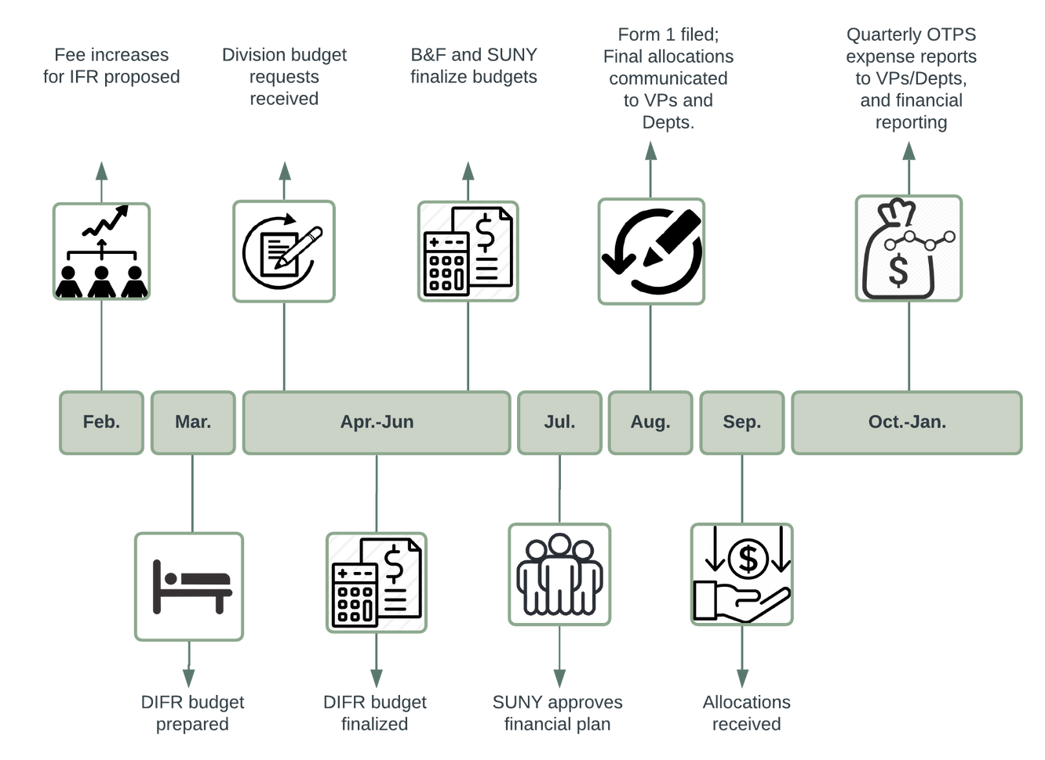
03
Annual Budget Cycle*
*Dependent on SUNY

Slide 7
04
Recharges
1%
TS
7%
OTPS
18%
PSR
74%
$58,248,866
FY 2021-2022 Financial Plan
(+16% from FY 2020-2021)

Slide 8
04
Recharges
0.3%
TS
1.8%
OTPS
11.8%
PSR
86.1%
$30,712,733
FY 2021-2022 Academic Affairs Total Budget
(+12% from FY 2020-2021)

Slide 9
04
Academic Affairs - 50.7%
Facilities - 9.5%
Student Affairs - 7.9%
ITS - 7.1%
Fixed Costs - 6.4%
B&F - 6.1%
UPD - 3.5%
Enrollment - 2.8%
Communications - 1.9%
President - 1.9%
HR - 1.1%
Advancement - 0.9%
DEI - 0.3%
0%
20%
40%
60%
All Funds - Allocations by Division

Slide 10
05
Prior Year Change - OTPS

Slide 11


06
Factors Affecting our Financial Position
FY 2021-2022
$2.0 million
$4.4 million
$130K
Lower tuition revenue
Lower fees & rentals revenue
Loss of auxiliary revenue
A marked decrease in enrollment since 2019 has resulted in revenue losses, -14% in total. Revenue losses were $2.6M for FY 2020-2021, and projected to be $2M for FY 2021-2022, for a total of $4.6M.
  NYIT contract loss ($1.3M). Residence hall lower density ($2.4M). Lower student fees and facilities rentals ($638K).
Loss of meals and auxiliary services (NYIT meals).

Slide 12

06
Factors Affecting our Financial Position
FY 2021-2022
$1.1 million
$350K
$1.7 million
Contractual obligation
Unanticipated expenses
AV - Violation abatements
Contractual obligations, including salaries, have increased in the last 3 years. Over 3 years it has represented $3.3 million.
Recent power outages (~$300K)
Restarting and preparing campus for fall: AV residence hall repairs, addition of kitchens, etc.
We must abate fire code violations in Academic Village Building A by June 2022.

Slide 13

07
Student
Enrollment
12,500
10,000
FY 2019-2020 to
FY 2021-2022
-3%
-12%
7,500
5,000
2,500
Student enrollment has significantly decreased since FY 2019-2020
Enrollment has decreased 12% from FY 2019-2020 to FY 2021-2022.
0
FY 2019-2020
FY 2020-2021
FY 2021-2022

Slide 14

08
SUNY Guidance
Temporary
Spending Constraints
Hiring Freeze
Implemented a temporary hiring freeze. Hires are prioritized based on health and safety, essential instruction and research in areas of high-need and high enrollment, critical student facing needs and revenue generation.
Reduced Expenses
Restrictions on overtime, with some exceptions. Elimination or deferment of non-essential extra service and course releases.
Reduction in energy consumption and costs.
Reduced Discretionary Expending
All discretionary spending must be suspended, if not mission critical. This includes memberships, travel, food/meals, events, and other expenditures that are not critical to the operation of the College.

Slide 15
09
HEERF III
American Rescue Plan - Institutional Portion
Emergency Grants, post 21/22
2.5%
HVAC, Distancing
28%
Lost Revenue
42%
Mental Health
5%
COVID-related Expenses
22.5%
$8,390,071

Slide 16

Questions
CFO
Martha Santana
Contact us anytime!
Budget Office
Pat Lettini
Jennifer Jimenez

