Slide 1

Welcome to the
NEW STUDENT ORIENTATION!
Presented by:
The Offices of BURSAR, FINANCIAL AID
of the Division of Business & Finance

Slide 2
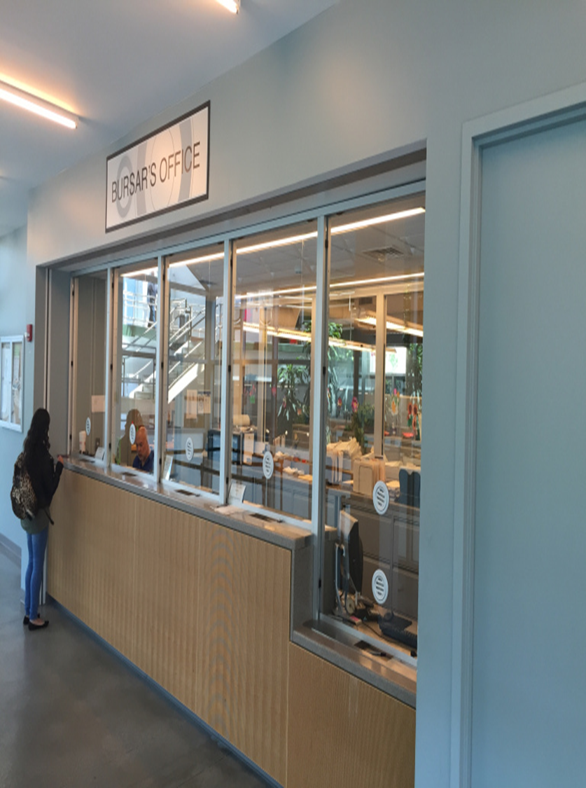
BURSAR’S OFFICE
OLD WESTBURY
NEW STUDENT ORIENTATION

Slide 3
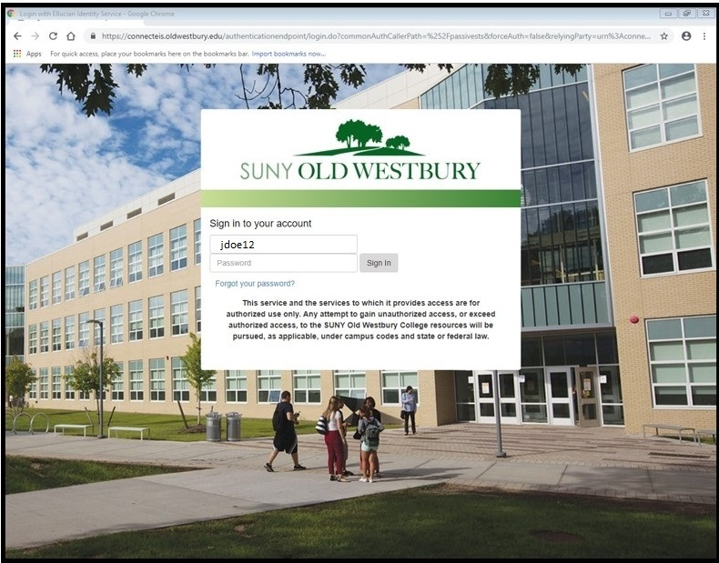
SIGN-IN
Username is part of your Old Westbury email without
the @ sign. Example: Jdoe or jdoe12
Email through https://connect.oldwestbury.edu

Slide 4

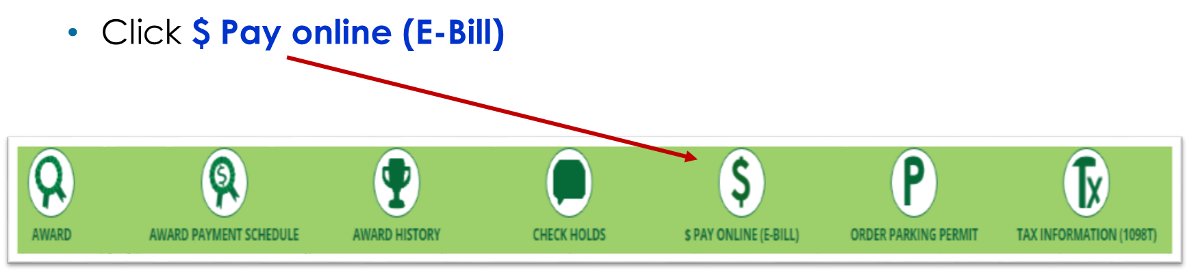
HOW TO ACCESS YOUR
ELECTRONIC BILL
Click the $ Finances Icon

Slide 5
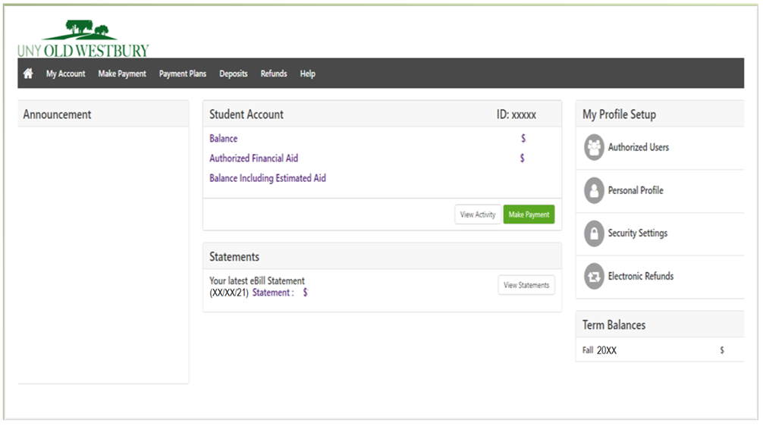
E-BILL HOME PAGE
IMPORTANT NOTICE:
Indicates the semester
Payment due date
Types of payments accepted, e.g. Visa, Mastercard, Discover or electronic check
If you expect to use financial aid, that aid must be authorized on your account in order to be deducted from the bill.
Any account with an outstanding balance will be charged Late payment Fees and a restriction will be placed on the account preventing a student from registering for future semesters and receiving transcripts.

Slide 6
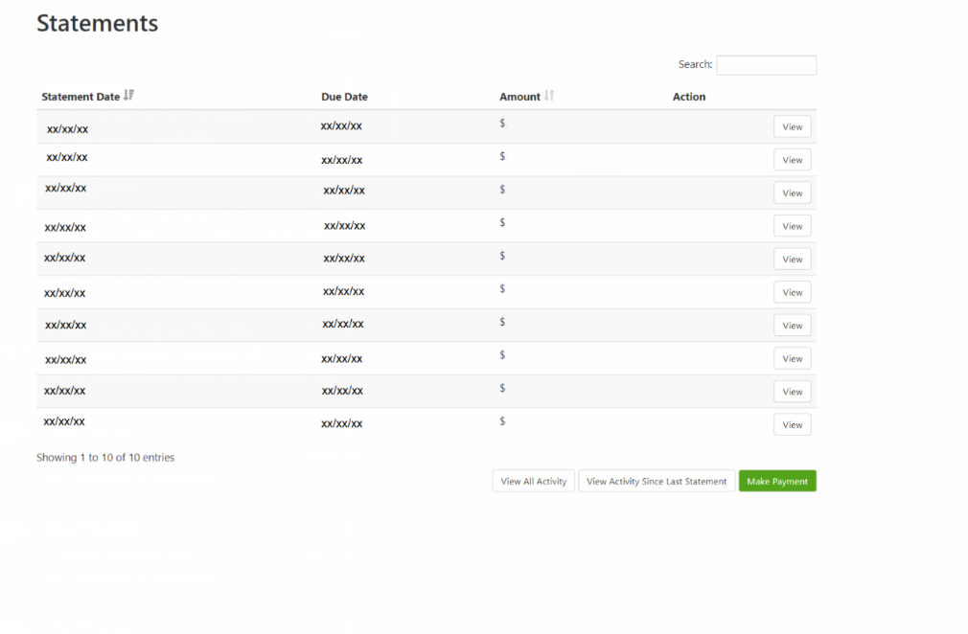
VIEW E-BILL STATEMENTS
VIEW BUTTONS

Slide 7
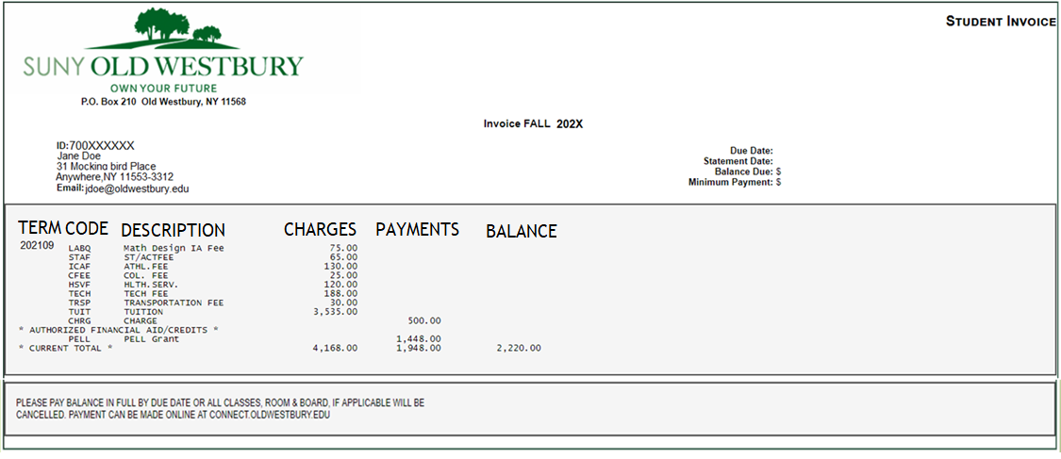
STATEMENT: INVOICE
The above image will change depending on the term.

Slide 8

FALL 2021
TENTATIVE BILL DUE DATE
AUGUST 12, 2021 by 5 p.m.

Slide 9
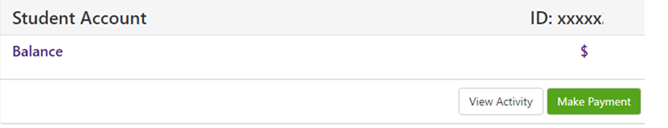
E- BILL MENU BAR
From the menu bar click Make Payment or click Make Payment button located to the right of View Activity button.

Slide 10
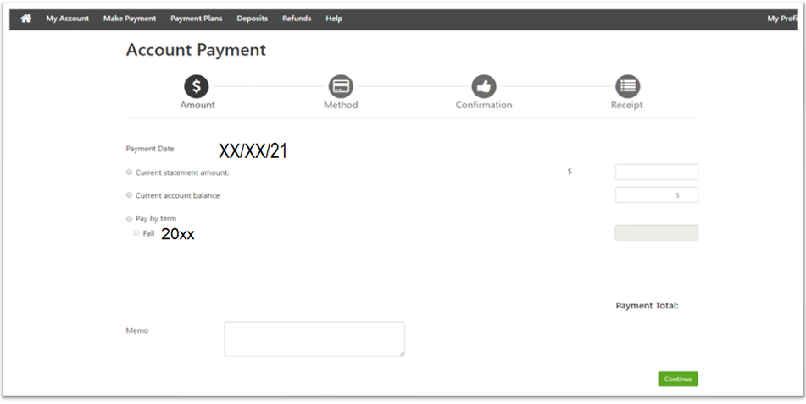
MAKE PAYMENT
Pay current statement balance
Pay by the term
NOTE: The image above will change depending on the term. Please be aware of the correct term.

Slide 11
MAKE PAYMENT (cont.)
Select payment method

Slide 12
MAKE PAYMENT (cont.)
Enter credit card number

Slide 13
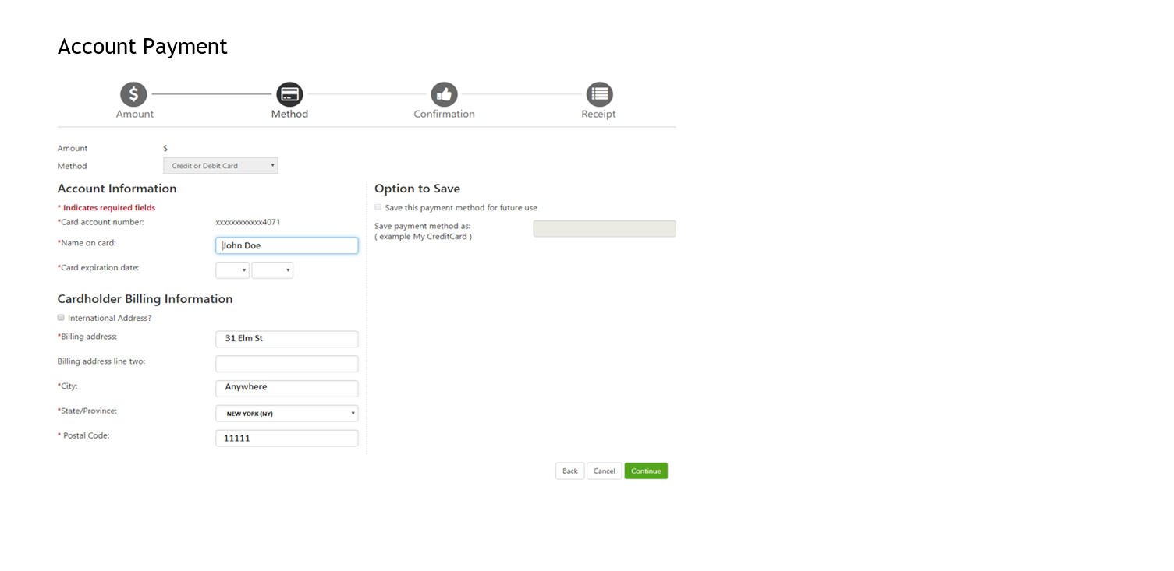
MAKE PAYMENT (cont.)
Select state / province

Slide 14
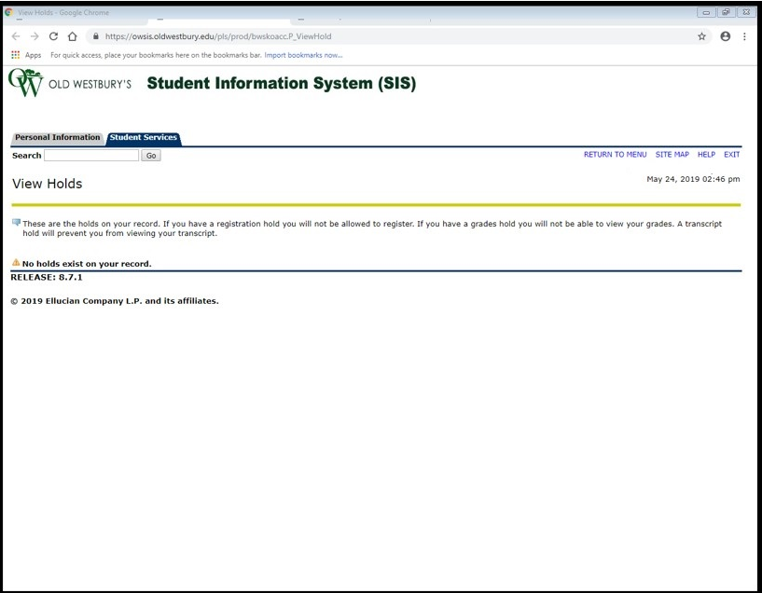

CHECK HOLDS
If you receive the above message while registering or requesting a transcript and is a Bursar hold or return check, please go to E-Bill Pay Online page.

Slide 15
CHECK HOLDS (cont.)
Click the $ Finances Icon
Click $ Pay online (E-Bill)

Slide 16
E-BILL MENU BAR
The Home Button – Takes you to the e-bill home page which contains summary Account Information and Profile.
My Account – Allows you to view your Current Activity, Statements, and Payment History.
Make Payment – Allows you to pay your Current or Previous account balance(s).
Payment Plans – Allows you to enroll in the Two or Three Payment Plan Option.
Deposits – Allows you to pay your Tuition or Room Deposit.
Refunds – Allows you to have your Refund(s) Electronically Direct Deposited into your Checking Account.
Help – Has Important Information regarding Fees, Authorized Financial Aid, Late Pay Fees,
Return Checks, Withdrawal, Debt Collection.

Slide 17
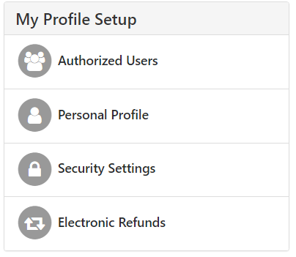
MY PROFILE SETUP
Allows you to setup authorized user(s) to view account activity, payment history and pay your bill.
Contains your student identification number and full name.
Two-Step Verification on how you would like to receive a passcode by text to existing or new mobile number or Email message to existing email address.
Allows you to have your refund direct deposited into your Checking Account.

Slide 18

FINANCIAL AID
OLD WESTBURY
NEW STUDENT ORIENTATION

Slide 19
ACCESS YOUR AWARD LETTER, AWARD PAYMENT SCHEDULE, AND AWARD HISTORY

Slide 20
AWARD (cont.)
Use this screen to accept or decline awards.

Slide 21
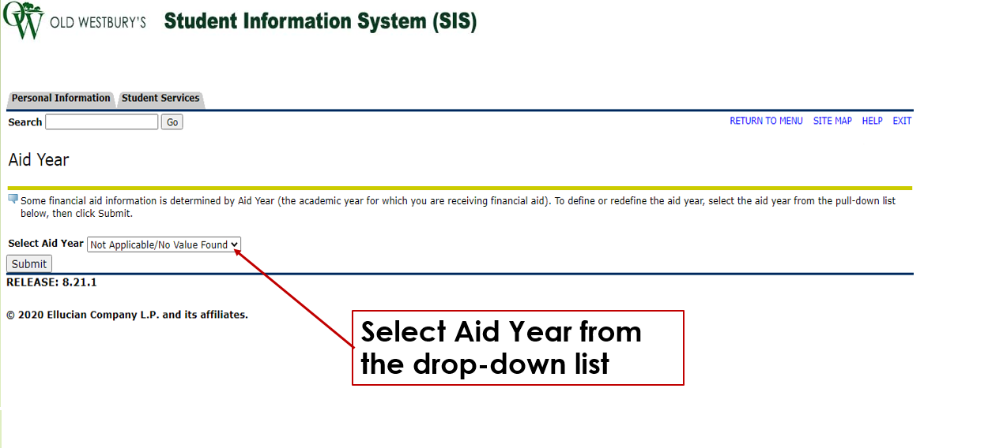
AWARD (cont.)

Slide 22
AWARD PAYMENT SCHEDULE

Slide 23
AWARD HISTORY

Slide 24
IMPORTANT THINGS TO REMEMBER
TENTATIVE FALL BILL DUE DATE: AUGUST 12, 2021 BY 5pm
FALL 2021 BILLS WILL BE OUT FIRST/SECOND WEEK IN JULY.
PAYMENT PLAN OPTIONS:
  TWO PAYMENT PLAN
  THREE PAYMENT PLAN
  ALL INFORMATION WILL BE SENT TO YOUR OLD WESTBURY EMAIL ADDRESS. WE ADVISE THAT YOU CHECK YOUR EMAIL DAILY.
  BE SURE THAT ALL OF YOUR FINANCIAL AID REQUIREMENTS HAVE BEEN SATISFIED.
  DATES, DEADLINES AND GENERAL INFORMATION:
  https://www.oldwestbury.edu/academics/registrar/class-schedule
  FINANCIAL LITERACY AT OLD WESTBURY:
  https://www.oldwestbury.edu/financial-aid

Slide 25
CONTACT BURSAR:
BURSAR@OLDWESTBURY.EDU
TEL: (516) 876-3168
CONTACT FINANCIAL AID:
FINANCIALAID@OLDWESTBURY.EDU
TEL: (516) 876-3223 OR 3224
CONTACT PAYROLL:
PAYROLL@OLDWESTBURY.EDU
TEL: (516) 876-3259 or 3191

